Slide 1

Update on the NOAA
FV3GFS-Chem Global Aerosol Model
Rick Saylor
NOAA Air Resources Laboratory
rick.saylor@noaa.gov
Jeff McQueen, Li Pan, Partha S. Bhattacharjee, Jack Kain, Ivanka Stajner (NWS/NCEP)
Georg Grell, Li Zhang, Raffaele Montuoro (ESRL/GSD)
Greg Frost, Stu McKeen (ESRL/CSD)
Barry Baker, Daniel Tong (ARL)
ICAP 11th WG Meeting, Tsukuba City, Japan, July 22-24, 2019

Slide 2
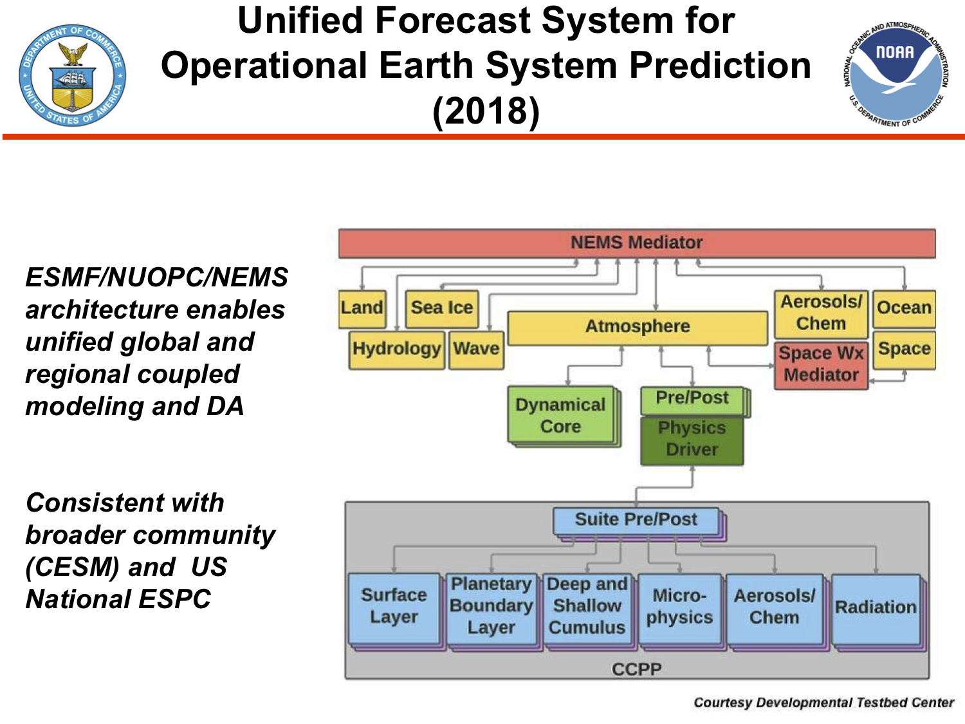
From Dorothy Koch’s presentation to the NOAA Coordination Meeting for UFS SIP Annual Update
May 14, 2019
GEFS-Aerosols (FV3GFS-Chem) slated to replace NGAC as a control member of the Global Ensemble Forecast System (GEFS) v12 in late summer 2020
ICAP 11th WG Meeting, Tsukuba City, Japan, July 22-24, 2019

Slide 3
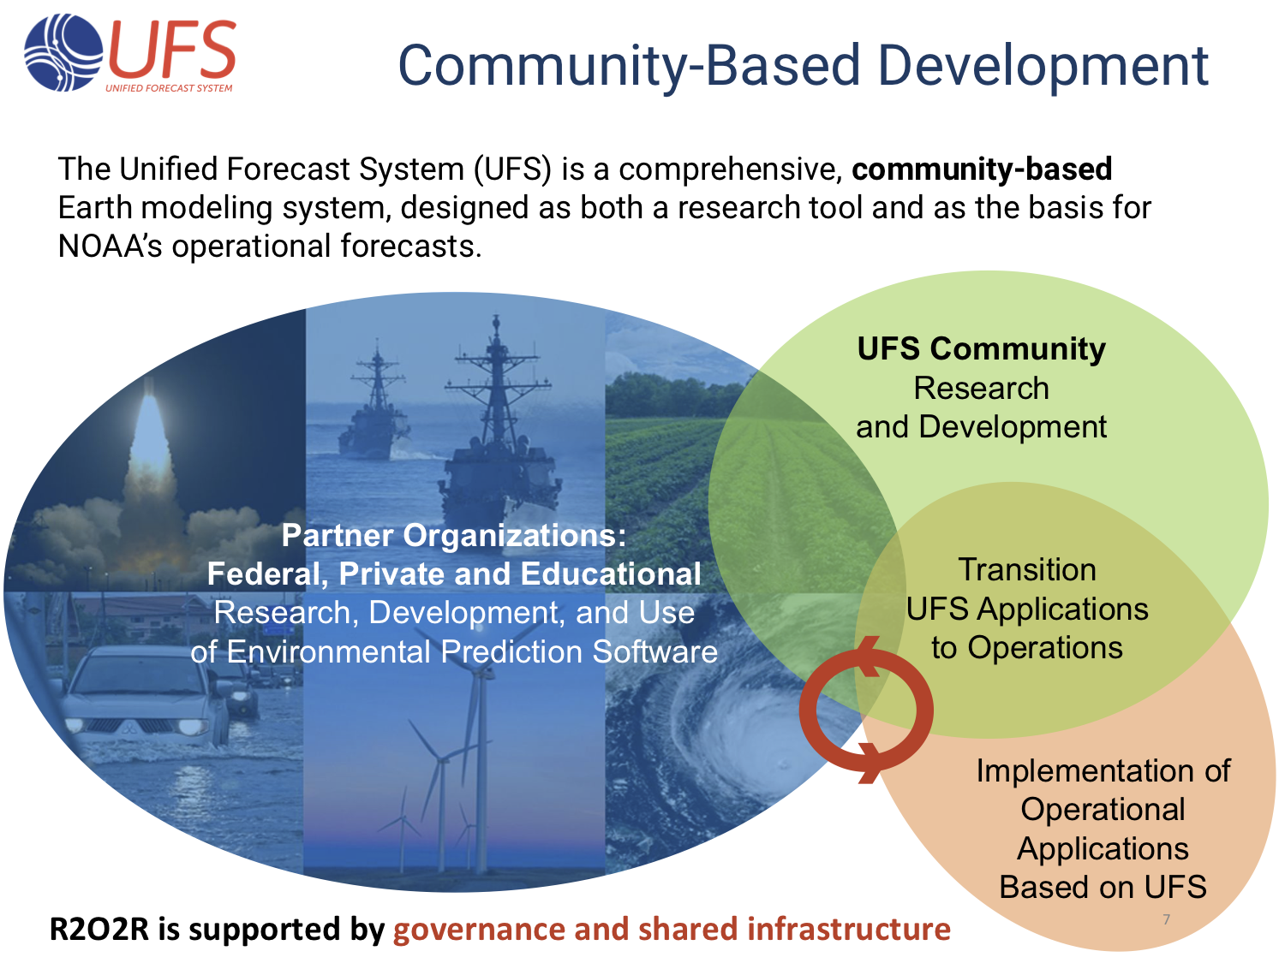
From Dorothy Koch’s presentation to the NOAA Coordination Meeting for UFS SIP Annual Update
May 14, 2019
Earth Prediction Innovation Center (EPIC) Community Workshop
Aug 6-8 in Boulder
ICAP 11th WG Meeting, Tsukuba City, Japan, July 22-24, 2019

Slide 4
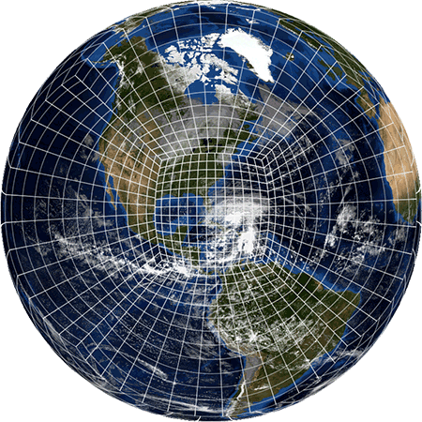
GFS physics, including sub-grid scale tracer transport
Other more advanced physics options are available through Common Community Physics Package (CCPP)
FV-3
GEFS-Aerosols initially only GOCART
Coupled chemistry suites
NUOPC coupled WRF-Chem-based
suite for global model
NUOPC coupled CMAQ suite for NAQFC
Simplified sulfur chemistry.
More sophisticated aerosol modules including secondary organic aerosols (SOA)
Operational CMAQ EPA modules in progress (CB06, AERO)
GOCART
GOCART RACM
RACM
SOA
ICAP 11th WG Meeting, Tsukuba City, Japan, July 22-24, 2019

Slide 5
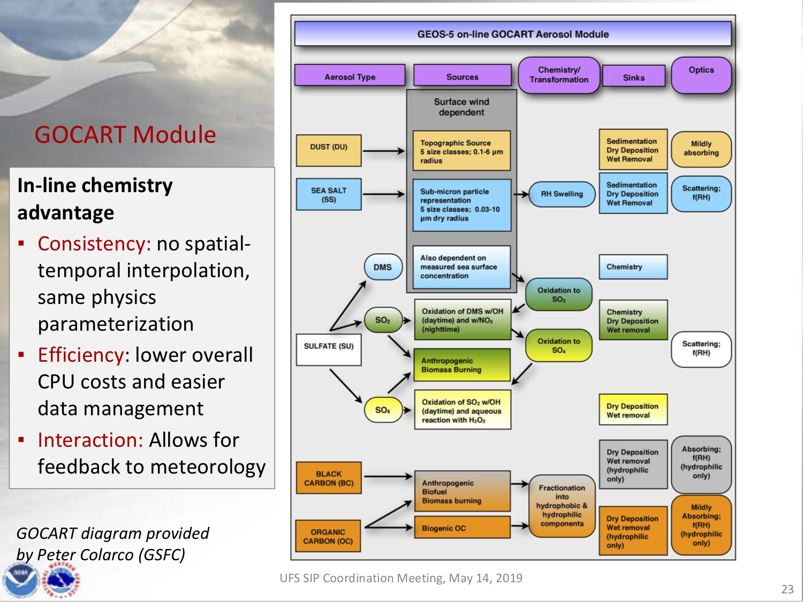
From Vijay Tallapragada’s presentation to the Coordination Meeting for UFS SIP Annual Update
May 14, 2019
ICAP 11th WG Meeting, Tsukuba City, Japan, July 22-24, 2019

Slide 6
Configuration for GEFS-Aerosols in GEFS v12
Resolution: C384, L64 to 120 hrs 4x/day
Transport:
Grid-scale transport provided by FV3
Sub-grid transport by PBL and convection in chemistry component or GFS physics
Deposition:
Wet deposition (for aerosols and sulfate) and dry deposition (all species)
Anthropogenic Emissions: CEDS-2014 (SO₂, PSO₄, POC, PEC)
Biomass burning: NESDIS Global Biomass Burning Emission Product (GBBEPx) used for fire size and location; 1d shear-dependent cloud model used to calculate injection heights and emission rates online
Dust: 2 options available; 5 size bins
AFWA dust scheme : Marticorena and Bergametti scheme provides bulk vertical dust flux; size distribution from Kok 2010 (PNAS)
FENGSHA dust scheme: scheme used in current NAQFC (Tong et al; Baker et al.)
Sea-salt: NASA GEOS-5 GOCART
Marine Dimethyl Sulfide: GOCART w/ monthly values as in Lana et al. (2011)
Chemistry cycled for initial conditions
Meteorological initial conditions from FV3GFS analysis
ICAP 11th WG Meeting, Tsukuba City, Japan, July 22-24, 2019

Slide 7
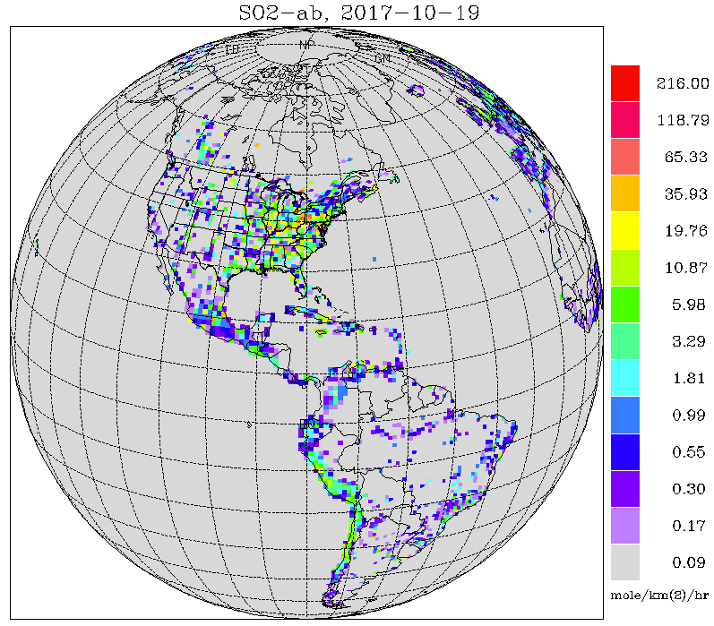
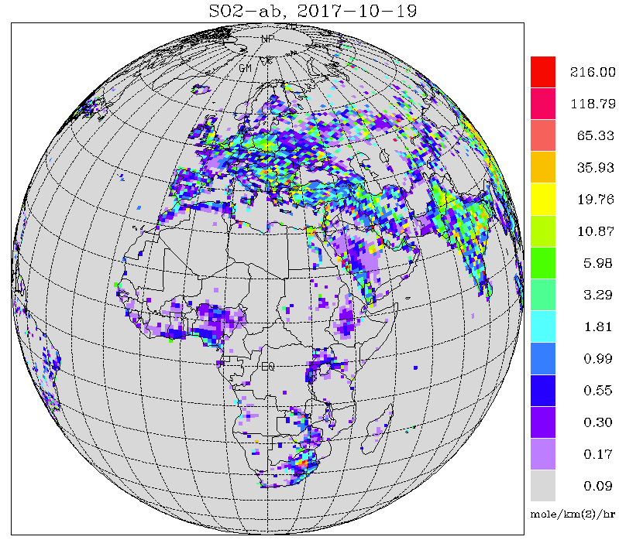
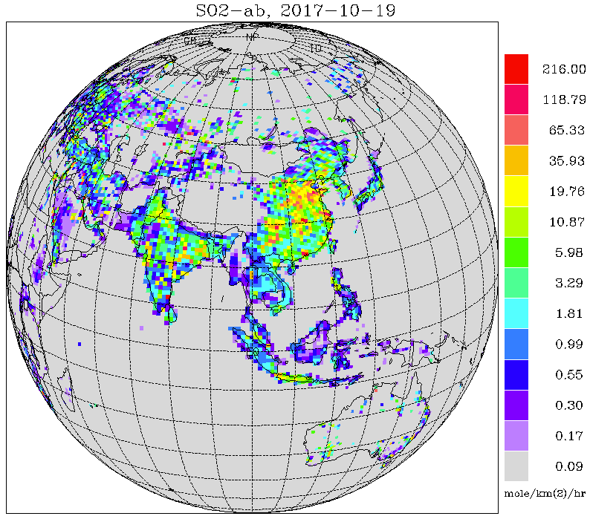
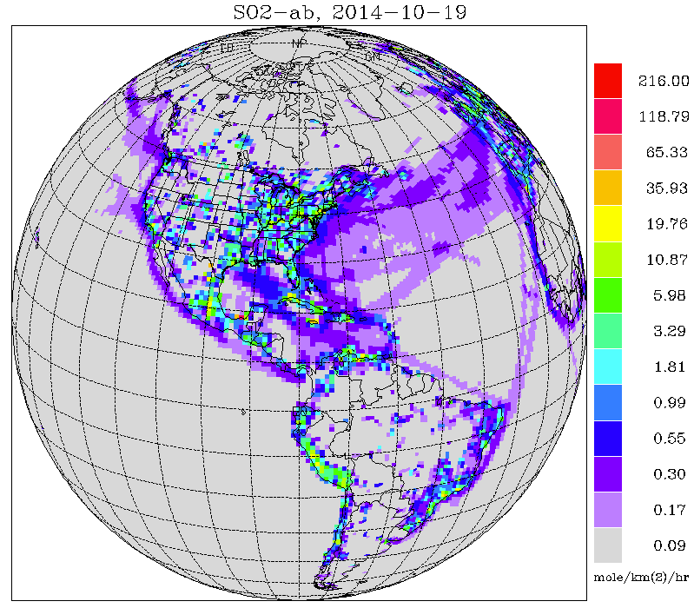
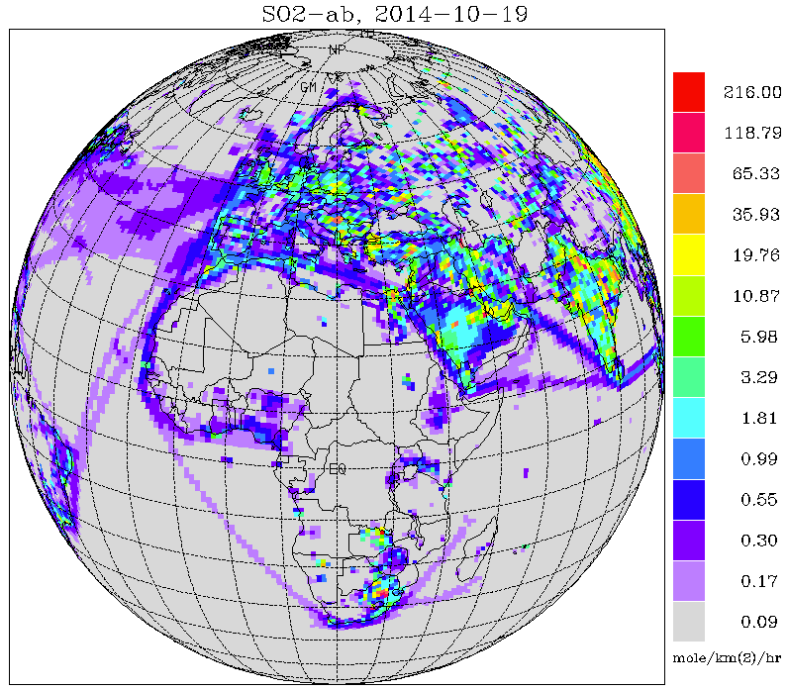
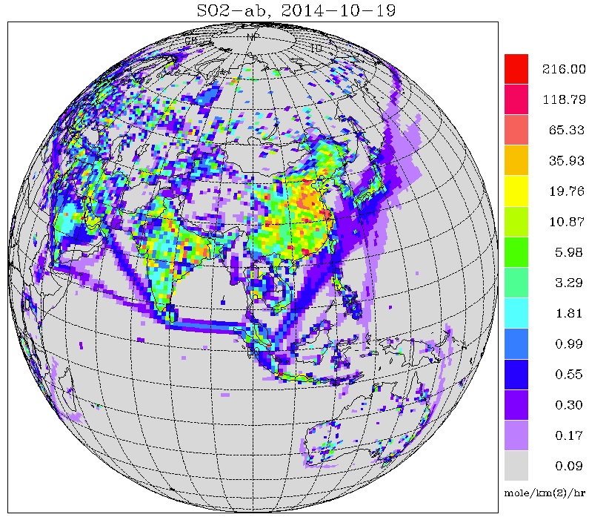
Emissions Upgraded to CEDS-2014 (CEDS-2016 as soon as available)
Anthropogenic SO₂ Emissions on FV3 grid (C96)
HTAP-2010
CEDS Emissions vs HTAP
CEDS-2014
ICAP 11th WG Meeting, Tsukuba City, Japan, July 22-24, 2019

Slide 8
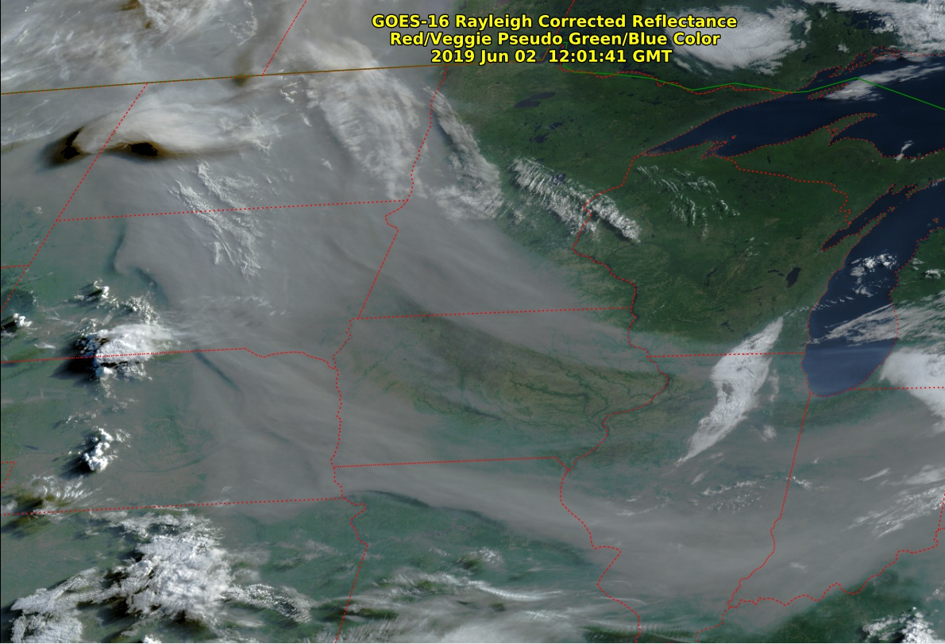
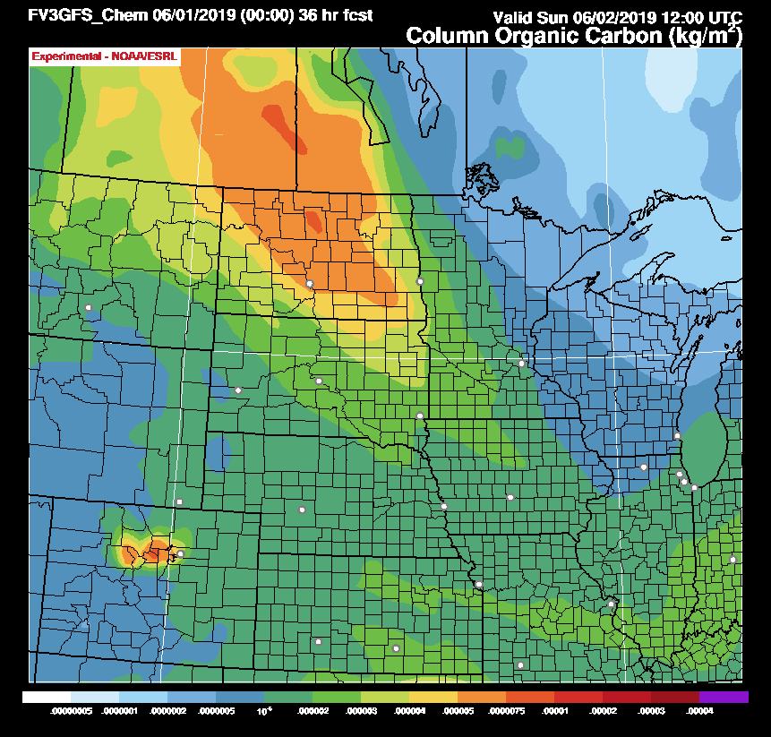
Real-Time Forecasts of North American Wildfires: Prelude to FIREX-AQ
June 2, 2019 – 12:00 UTC
Transport of Northern Alberta smoke reproduced well.
5 to 7.5 mg/m² column Organic Carbon over central ND.
Compared to HRRR-Smoke: 50 to 80 mg/m² .
Compared to RAP-Smoke: 30 to 60 mg/m² .
https://fim.noaa.gov/FV3chem
ICAP 11th WG Meeting, Tsukuba City, Japan, July 22-24, 2019
6/2/19

Slide 9
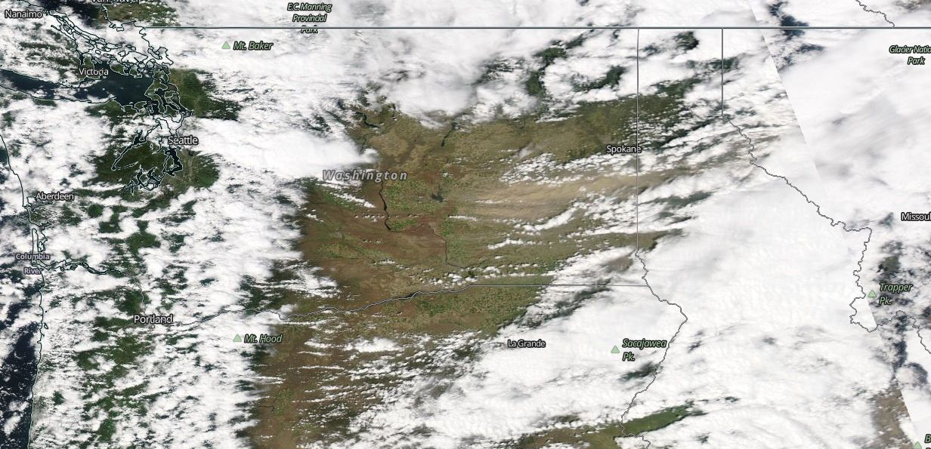
FENGSHA - National Air Quality Forecast Capability (NAQFC)
12:30 p.m, May 3,2010
Washington
MODIS-AQUA True Color NASA Worldview
FENGSHA used in NAQFC to forecast dust emissions from cropland, rangeland, and deserts.
ICAP 11th WG Meeting, Tsukuba City, Japan, July 22-24, 2019

Slide 10
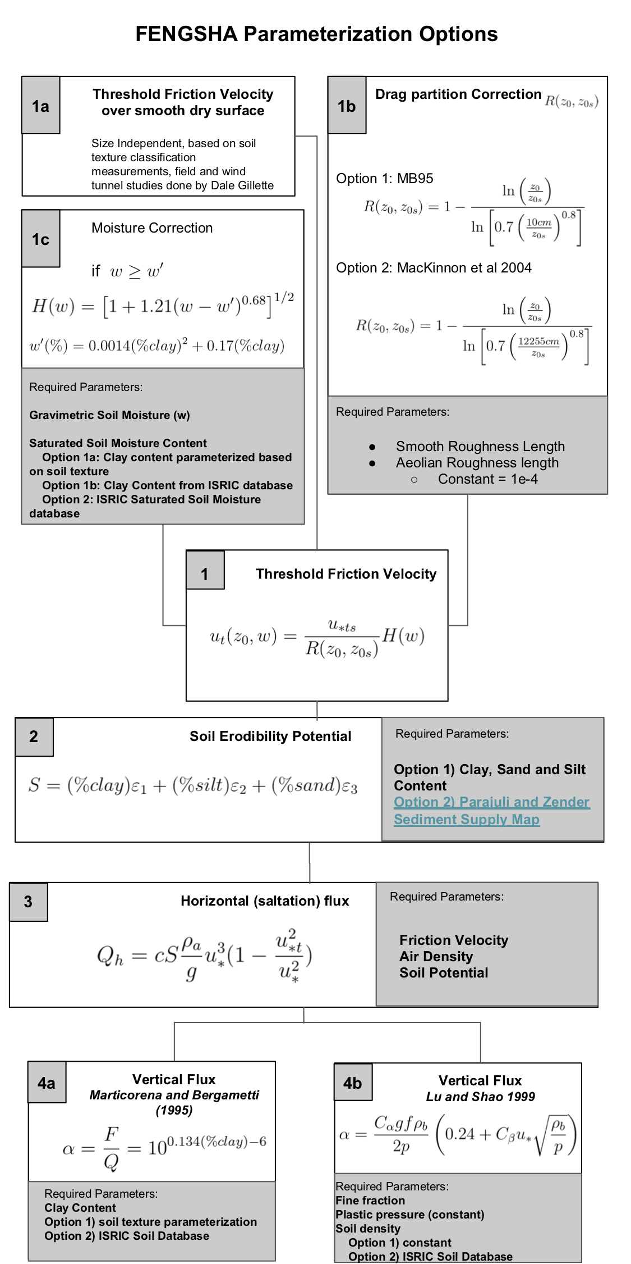
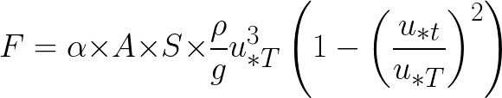
FENGSHA dust scheme (Tong et al., Baker et al. in prep.)
Surface Friction
Velocity
Surface Threshold
Velocity
Vertical Dust Flux
ICAP 11th WG Meeting, Tsukuba City, Japan, July 22-24, 2019

Slide 11
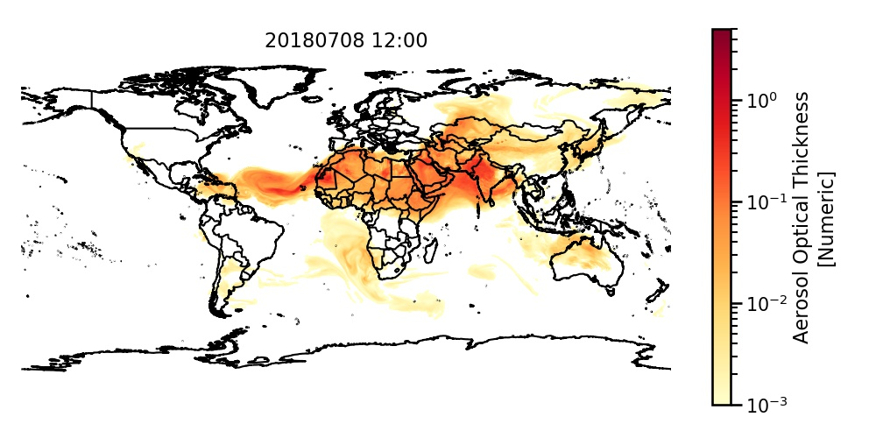
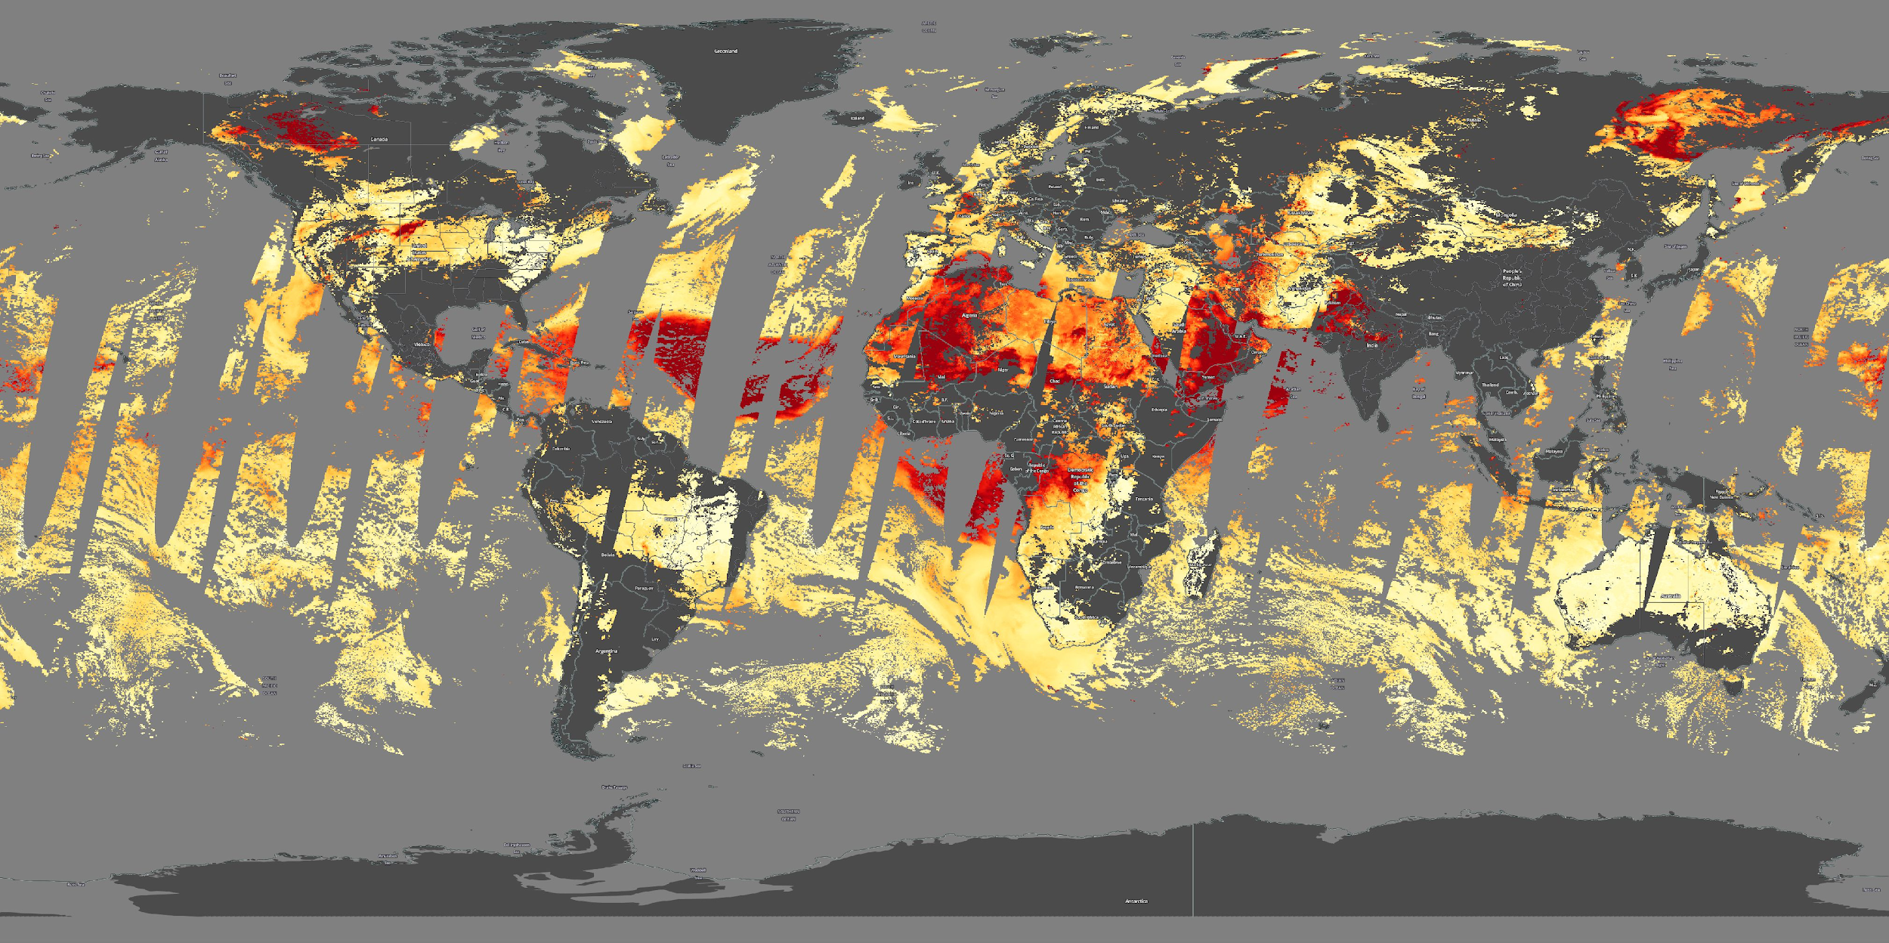
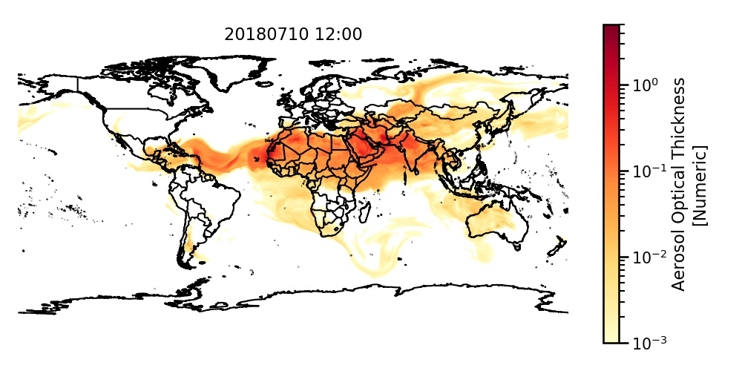
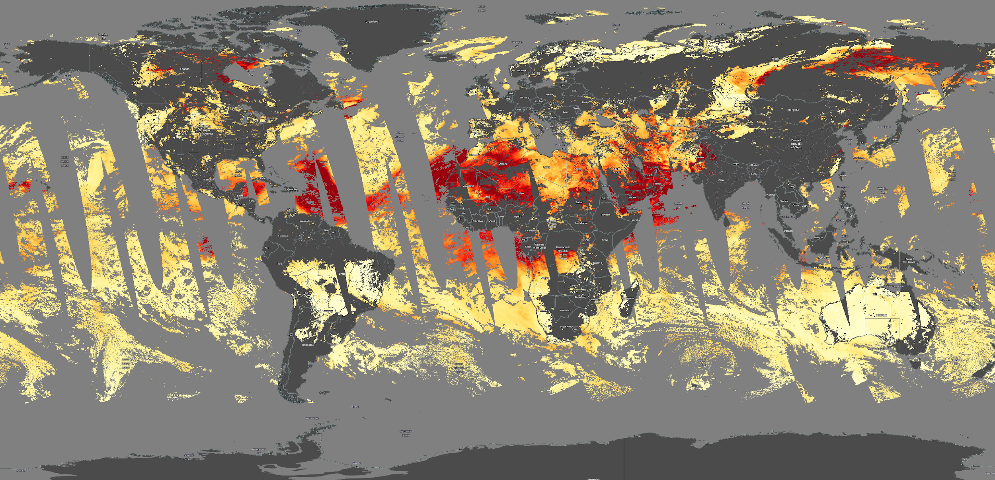
FENGSHA - FV3GFS-Chem
Likely fire locations circled
ICAP 11th WG Meeting, Tsukuba City, Japan, July 22-24, 2019

Slide 12
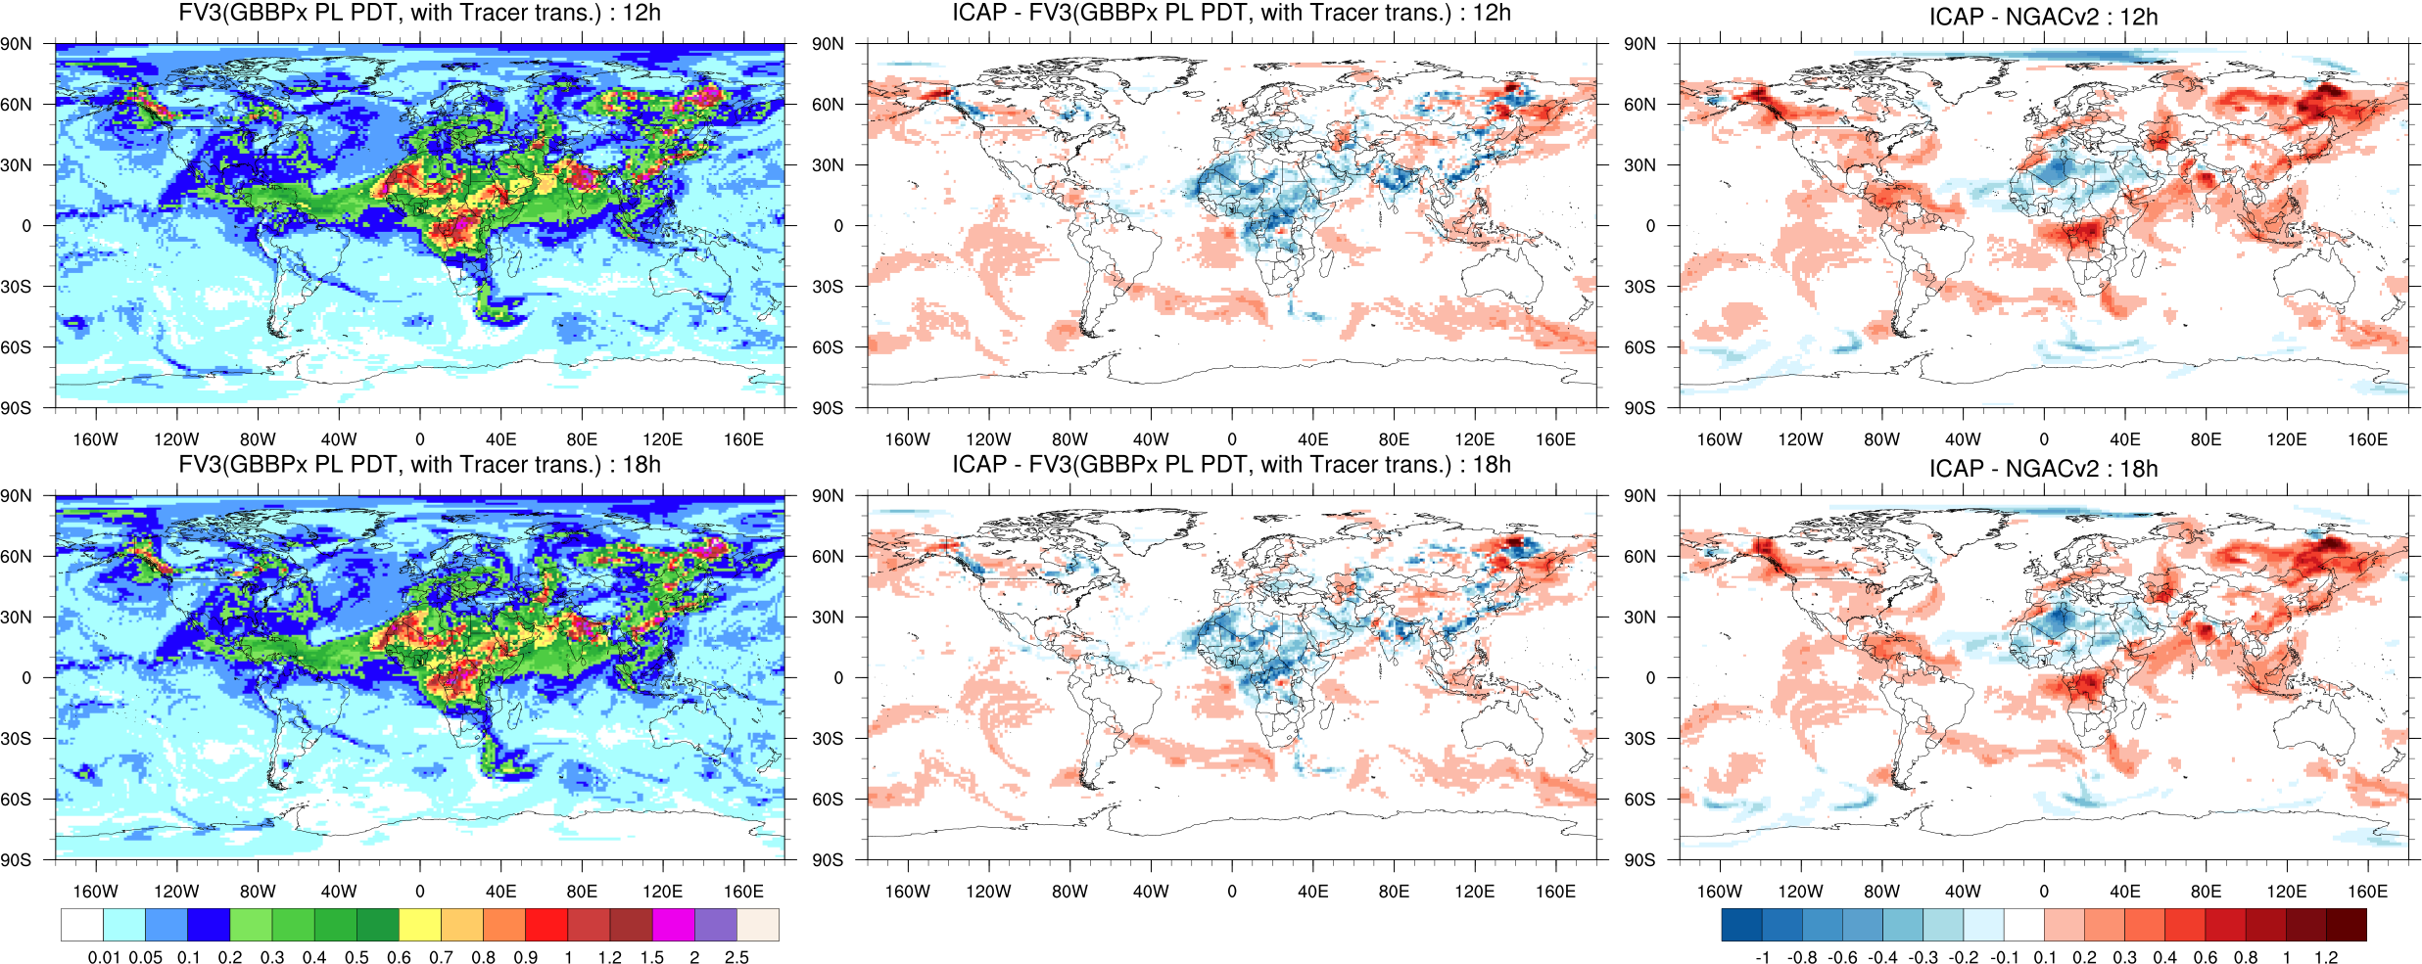
Total AOD at 550 nm - July 1, 2019
Clear improvement over NGACv2
ICAP 11th WG Meeting, Tsukuba City, Japan, July 22-24, 2019

Slide 13
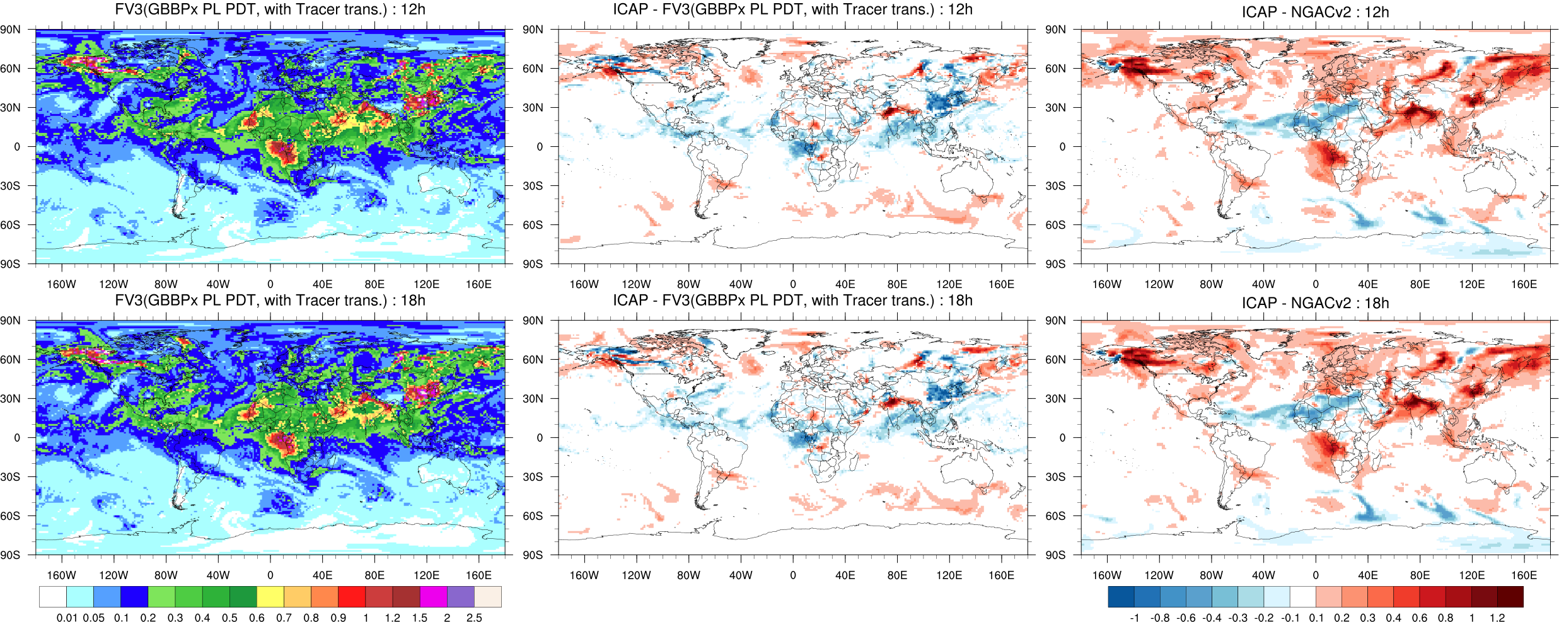
Total AOD at 550 nm - July 14, 2019
Clear improvement over NGACv2
ICAP 11th WG Meeting, Tsukuba City, Japan, July 22-24, 2019

Slide 14
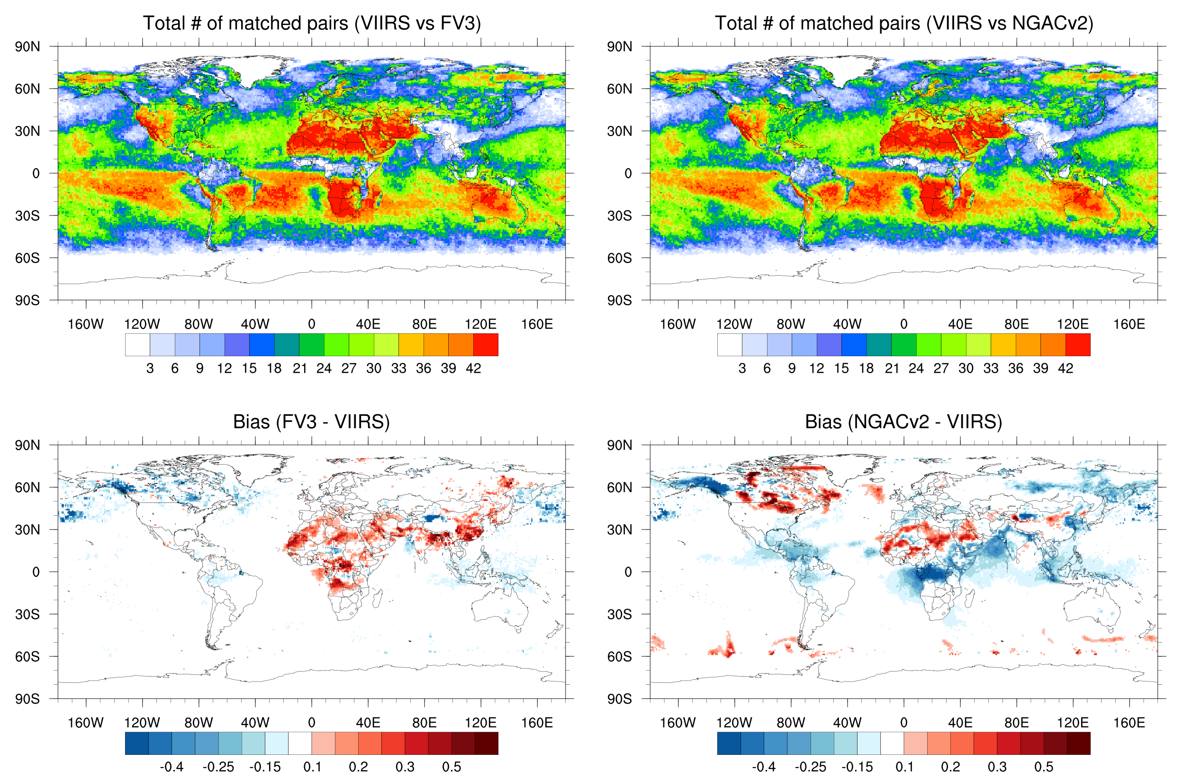
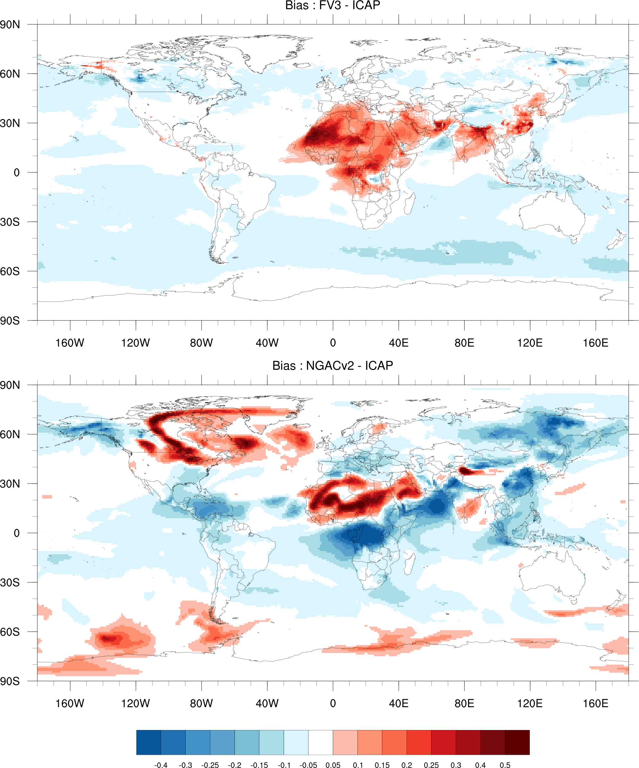
Comparison against ICAP forecasts and independent satellite (VIIRS Deep blue) indicate improvement with FV3
‹#›
ICAP 11th WG Meeting, Tsukuba City, Japan, July 22-24, 2019
ICAP 11th WG Meeting, Tsukuba City, Japan, July 22-24, 2019

Slide 15
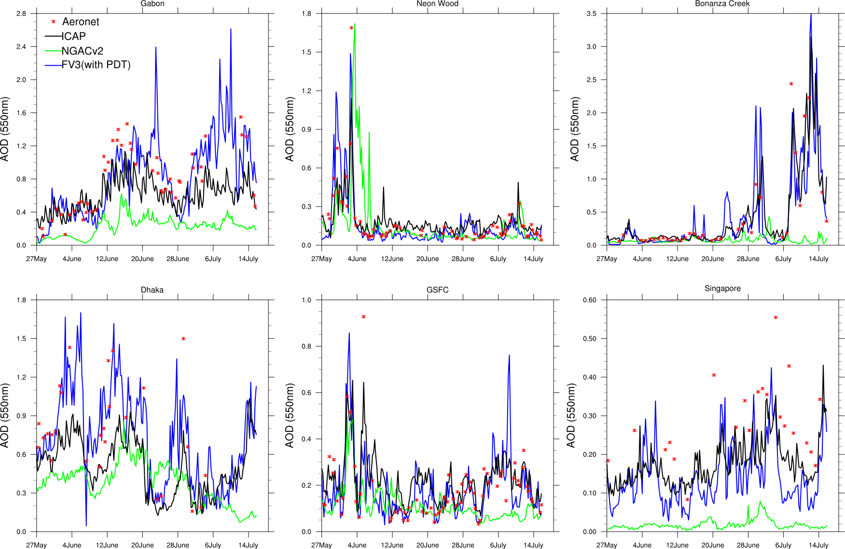
BB dominated AERONET locations (top row) and over urban areas w/ mixed aerosols (bottom row)
illustrate improvement over NGACv2
ICAP 11th WG Meeting, Tsukuba City, Japan, July 22-24, 2019

Slide 16
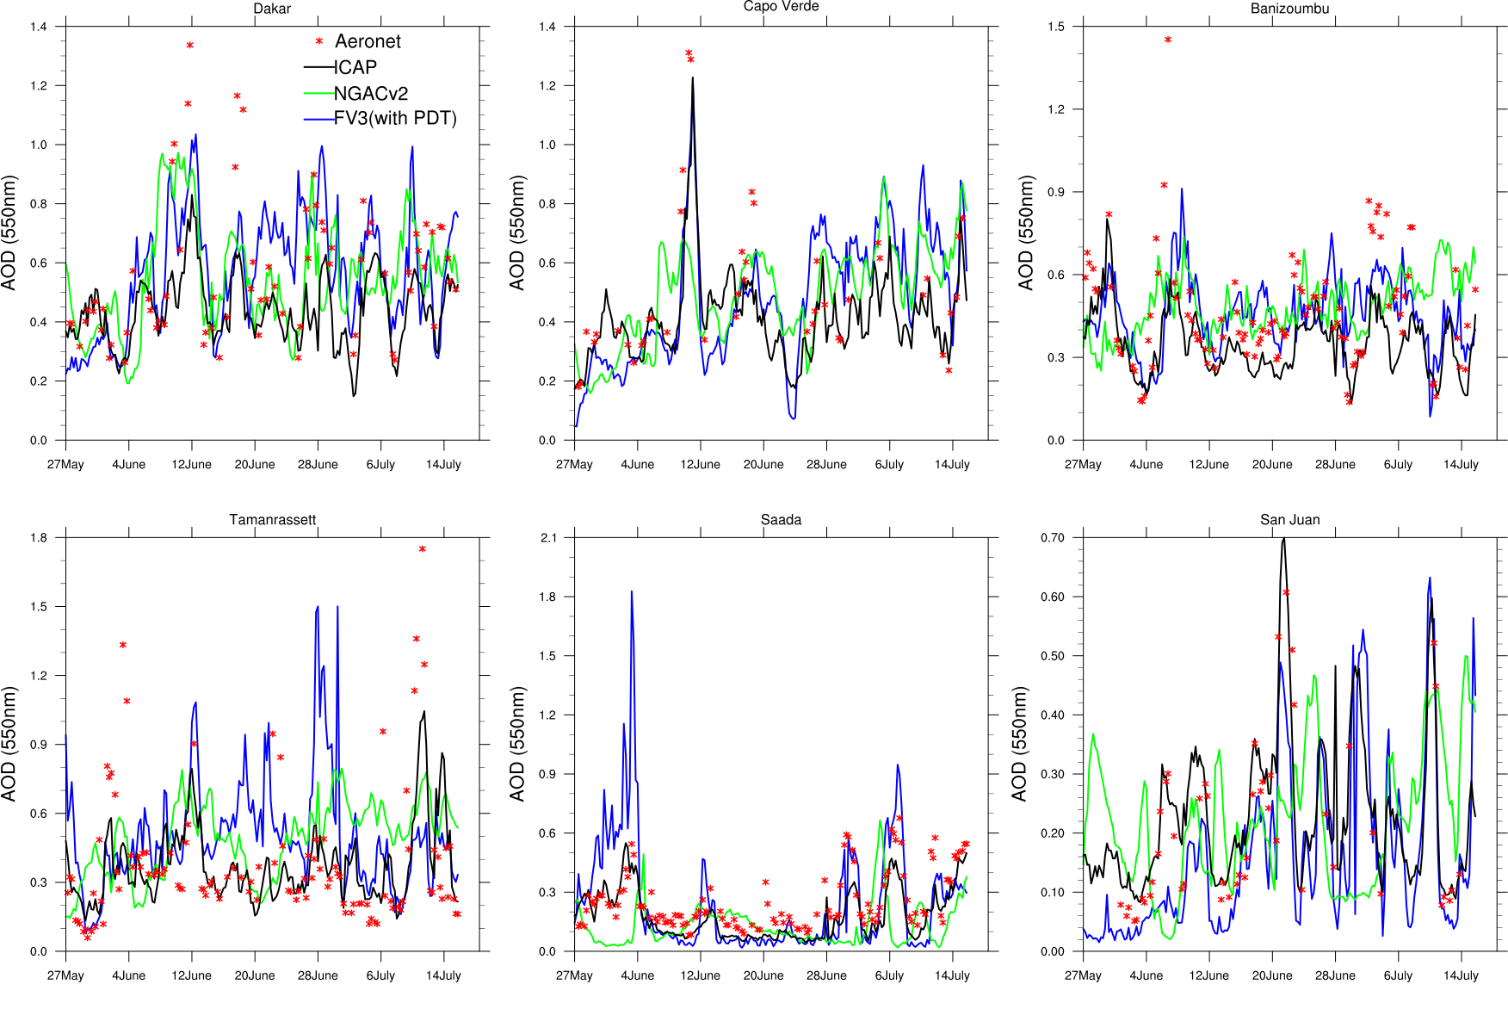
Dust dominated AERONET locations both near source and downwind sites, FV3 matches more closely with ICAP and should improve further with FENGSHA
‹#›
ICAP 11th WG Meeting, Tsukuba City, Japan, July 22-24, 2019
ICAP 11th WG Meeting, Tsukuba City, Japan, July 22-24, 2019

Slide 17
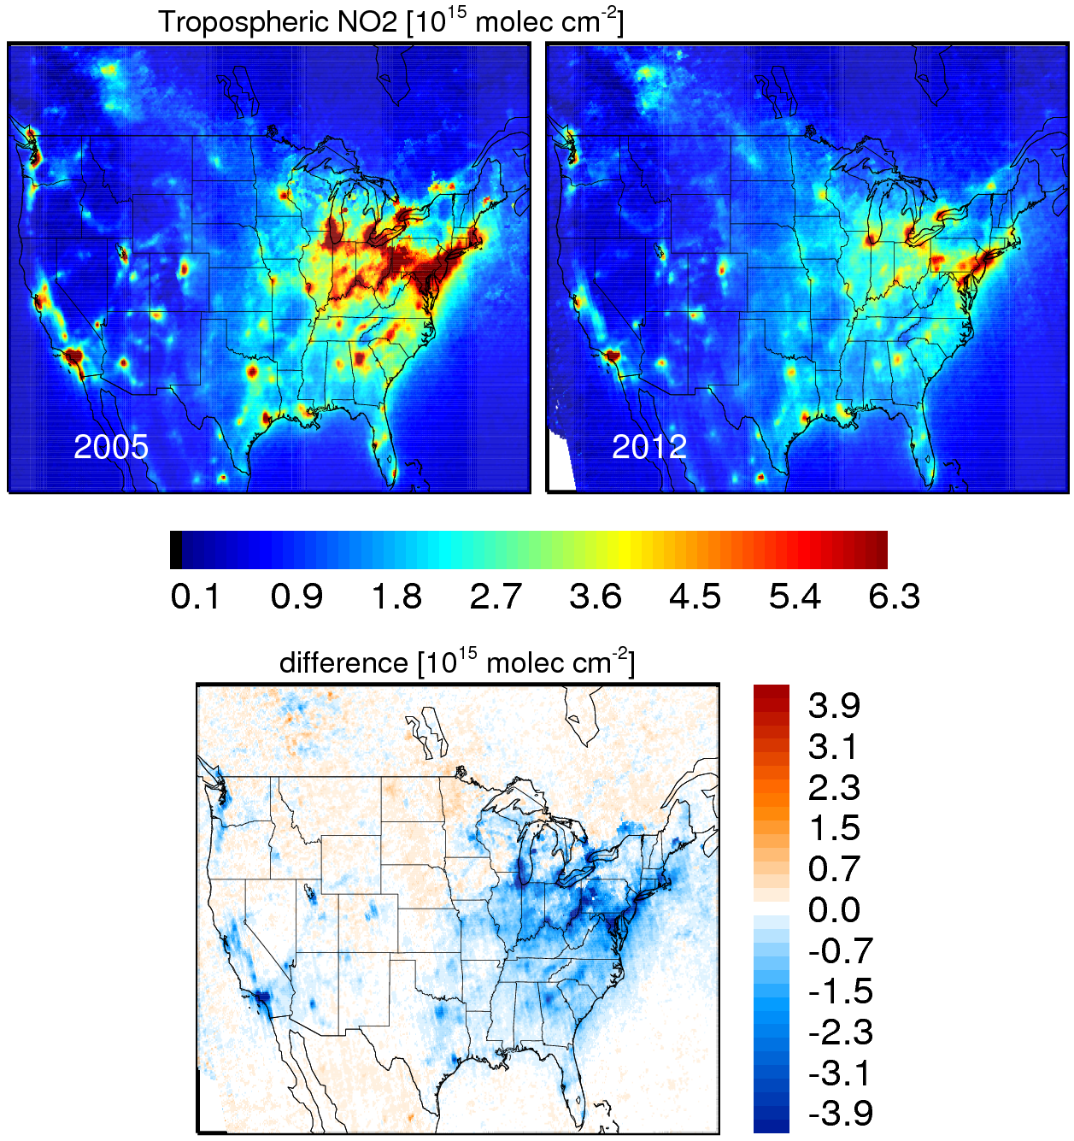
Future Developments: Emissions Data Assimilation
Satellite data (OMI/OMPS) used to adjust base year emissions of SO₂ to near real time.
Emissions Data Assimilation (EDA) techniques developed at NOAA Air Resources Laboratory and used in NAQFC.
ICAP 11th WG Meeting, Tsukuba City, Japan, July 22-24, 2019

Slide 18
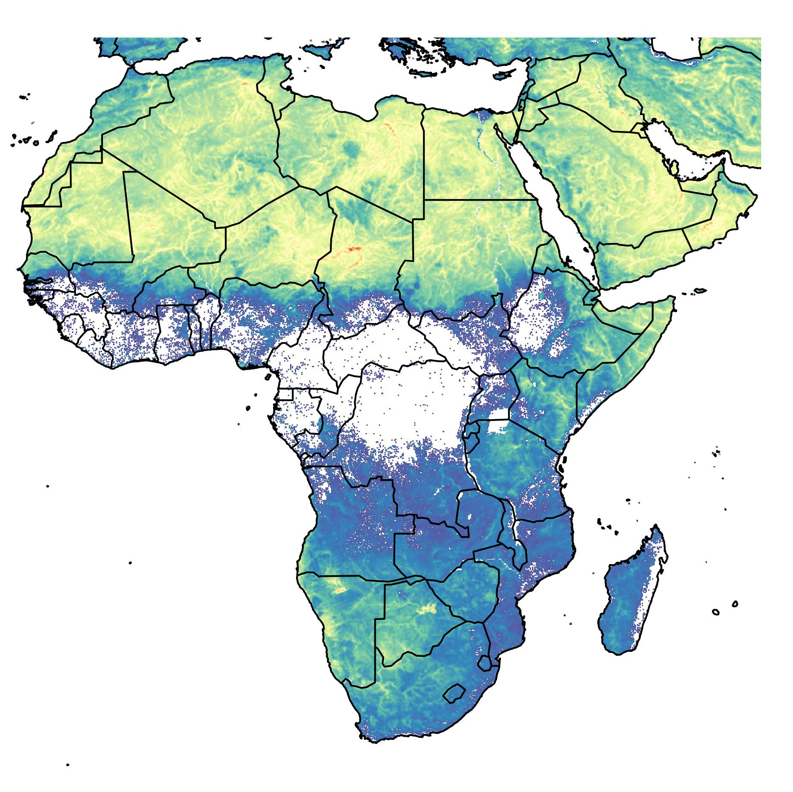
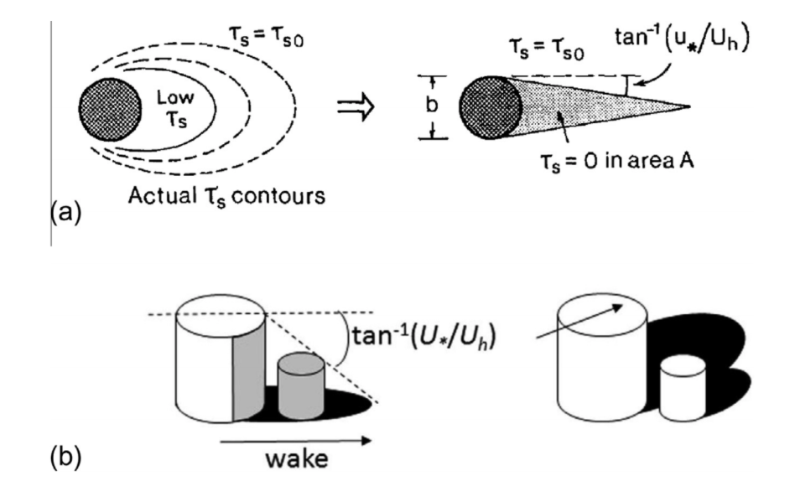
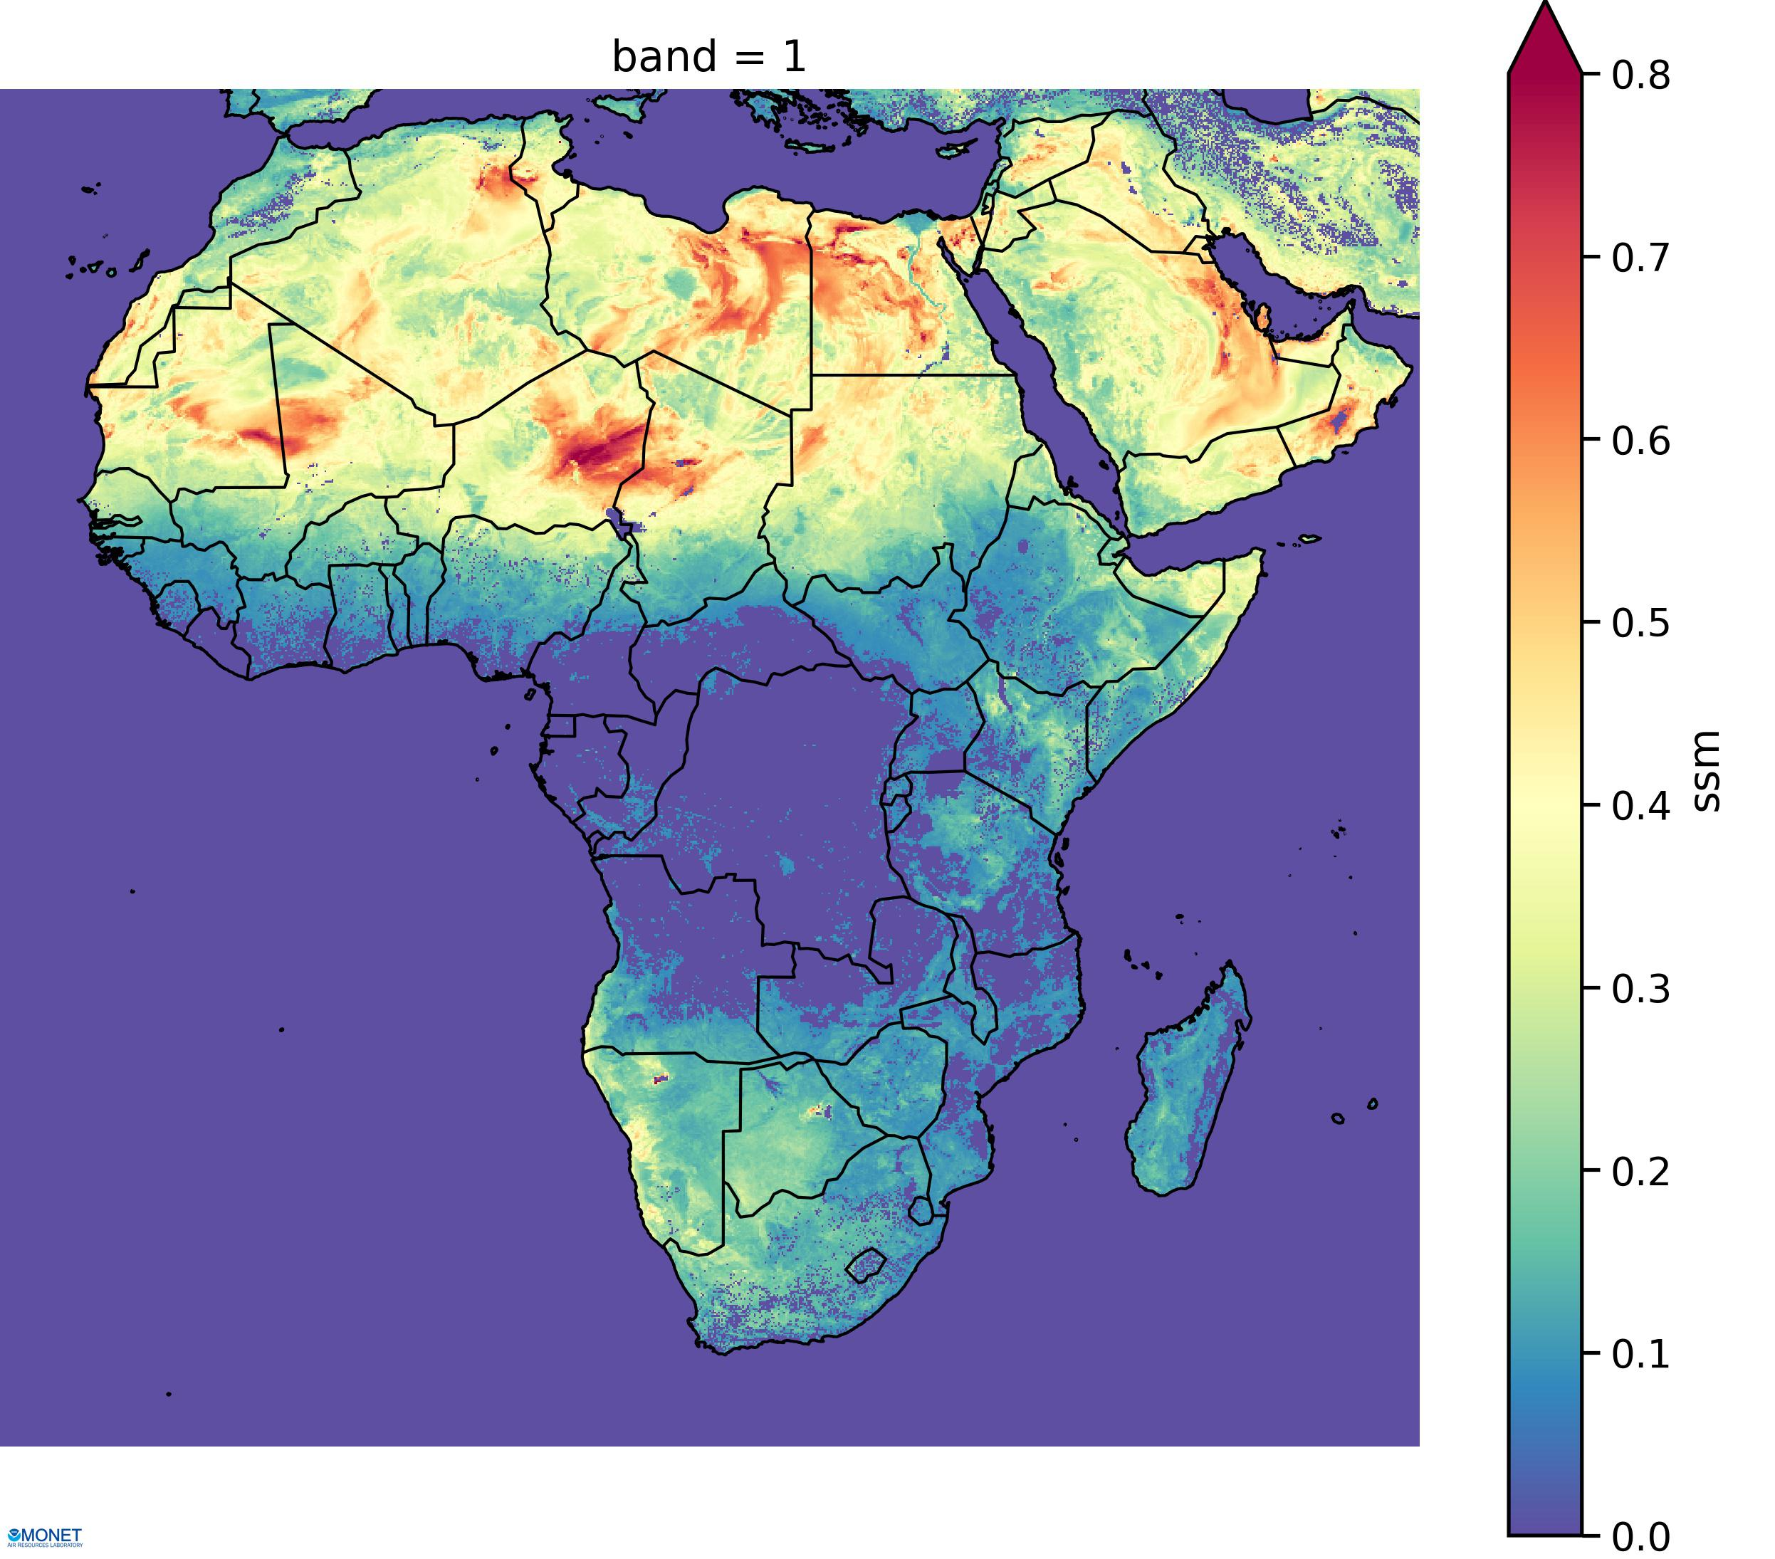
Future Developments: FENGSHA albedo
Parajuli & Zender (2017) sediment supply map
Low contrast between high dust sources and low dust sources
Static (no seasonality)
Coastal values biased low
Use an albedo-based approximation of aerodynamic sheltering (Lw) to adjust surface roughness and dust emissions (Chappell et al., 2016).
Baker & Schepanski sediment supply map
Higher contrast between high and low dust sources
Seasonal (satellite albedo)
Better representation of coastal source regions
ICAP 11th WG Meeting, Tsukuba City, Japan, July 22-24, 2019

Slide 19
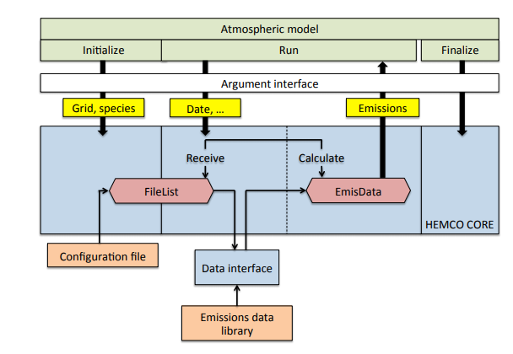
Future Developments: NOAA Emissions and eXchange Unified System (NEXUS)
Features
Derived from NASA/Harvard HEMCO
ESMF compliant for use inline with NUOPC and NGGPS.
Self described input and output files (netCDF)
Able to handle many different datasets (HTAP, CEDS, NEI, etc.).
Update rapidly with new inventories or satellite/ground observations.
Apply temporal, speciation, and spatial/mask profiles.
Run online or offline driven by different datasets and models.
Provide consistent interface to other Earth system components (land, ocean, etc).
Include deposition in gas phase and aerosol phase.
Include bi-directional processes for NH₃ and more.
Include inline emissions, dust, fire, marine, biogenics, etc.
Keller, C. A., et al.: HEMCO v1.0: a versatile, ESMF-compliant component for calculating emissions in atmospheric models, Geosci. Model Dev., 7, 1409-1417, 2014.
ICAP 11th WG Meeting, Tsukuba City, Japan, July 22-24, 2019

Slide 20
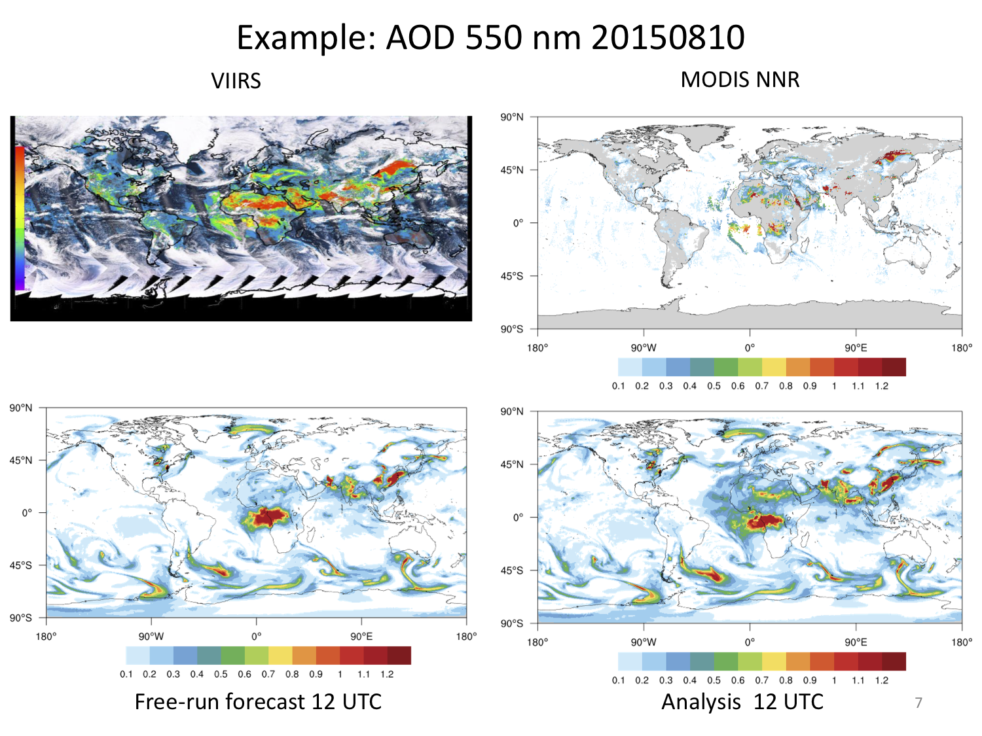
Future Developments: Aerosol Data Assimilation
USWRP Project led by Mariusz Pagowski, NOAA Boulder
Calculate “climatological” background error statistics from operational GEFS-Aerosols and deploy near real-time 3D-Var (GSI) based assimilation of MODIS and VIIRS AOD retrievals at 550 nm
Develop ensemble perturbation strategies specific for aerosols and evaluate the quality of the ensemble and 3D-VarEns in comparison with 3D-Var
Verify forecasts against MERRA-2 and CAMSIRA, multi-channel NNR and VIIRS AOD retrievals and surface observations
Implement AOD assimilation within the JEDI framework
Deploy a cycled aerosol data assimilation system for the national real-time aerosol forecasting.
ICAP 11th WG Meeting, Tsukuba City, Japan, July 22-24, 2019

Slide 21
Challenges
Operational constraints on model complexity (computational efficiency) vs. best representation of known science
Consistency and continual improvement of emissions inputs
Two-way coupling of aerosols and composition with meteorology
Aerosol data assimilation and post-processing of model products
Consistency of atmospheric composition simulations between global and regional domains
Evaluation of model results beyond standard large-scale or long-term metrics
Consistency in land surface-atmosphere interactions for both physical (surface energy, momentum and moisture fluxes) and chemical (emissions and deposition) processes
Limited resources for model improvements, transition to operations and model maintenance
Limited HPC resources
ICAP 11th WG Meeting, Tsukuba City, Japan, July 22-24, 2019

Slide 22
Thanks!
rick.saylor@noaa.gov

